Slide 1

Untitled Team Sprint 3
Myles Wright, Parker Winters, Nick Stitely, Matthew O’Hern

Slide 2


Sprint 3 Goals
Store database information in class objects
As an Admin, I want to be able to view a list of open tickets
Create wireframes for Settings page, report generation page, and view all users page
As an Admin, I want to be able to view existing problems
As an Admin, I want to be able to go to a page with a list of all users
As a user, I want to be able to edit my account information
As a Report Manager, I want to be able to view types of reports that can be generated
Make report table in database
Challenge 1
Challenge 3

Slide 3

IT Support Help Desk
Context
Problem statement
Internal support ticketing system
Tickets are submitted and solved by the IT Support Team
Four user types
Admin
IT Support Team Member
Project Member
Report Manager

Slide 4
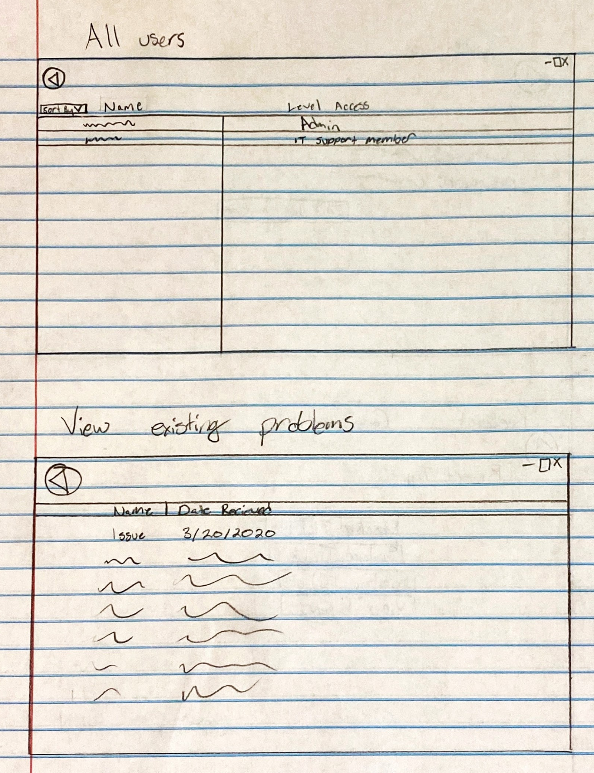
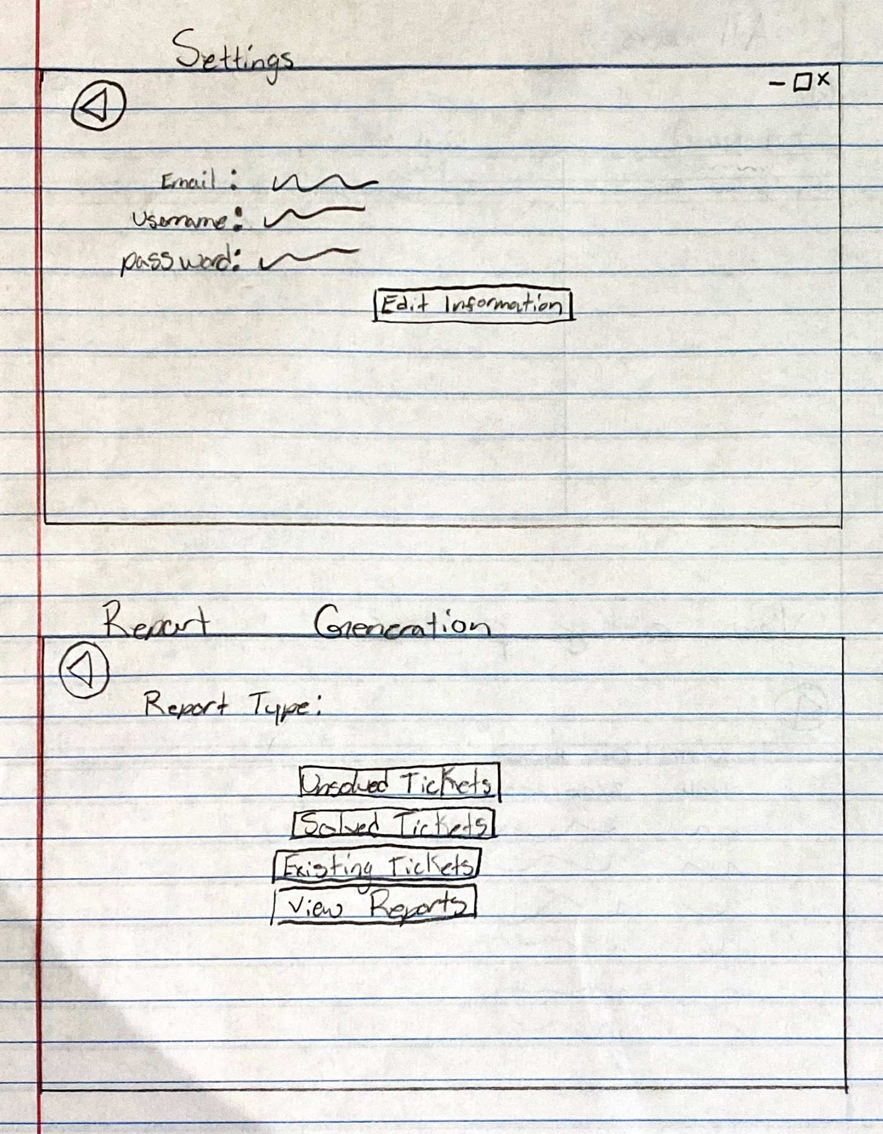
Wireframes

Slide 5
Product Demo
What updates do we have to show?

Slide 6
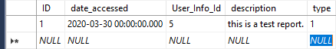
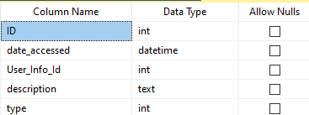
Report Table

Slide 7
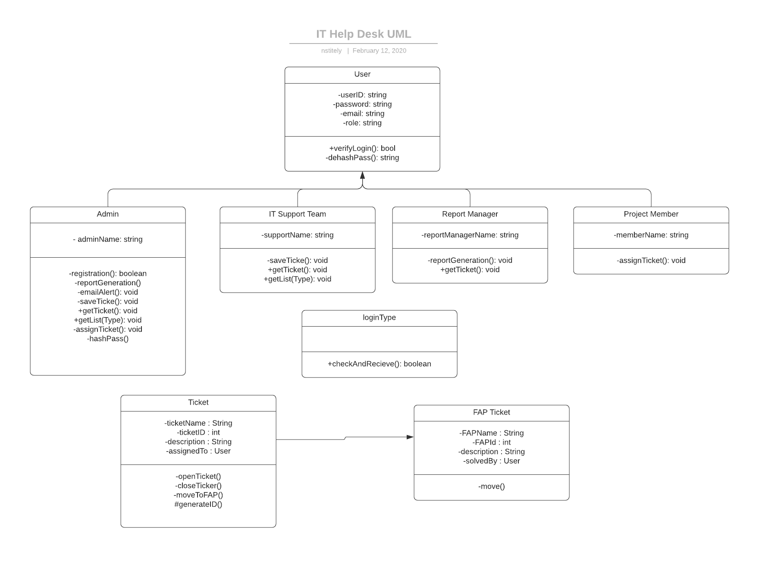
Storing Data in Class Objects
Ticket class
Structure of user classes

Slide 8

Issues and Moving Forward
Covid-19
Online classes
Implement functionality for GUI’s
Refine and improve current functionality and design elements
Work on backlog items

Slide 9
Questions?
Hi

